Slide 1
The Analysis and Design of Computer Algorithms
CIS*3490 Winter 2021

Slide 2
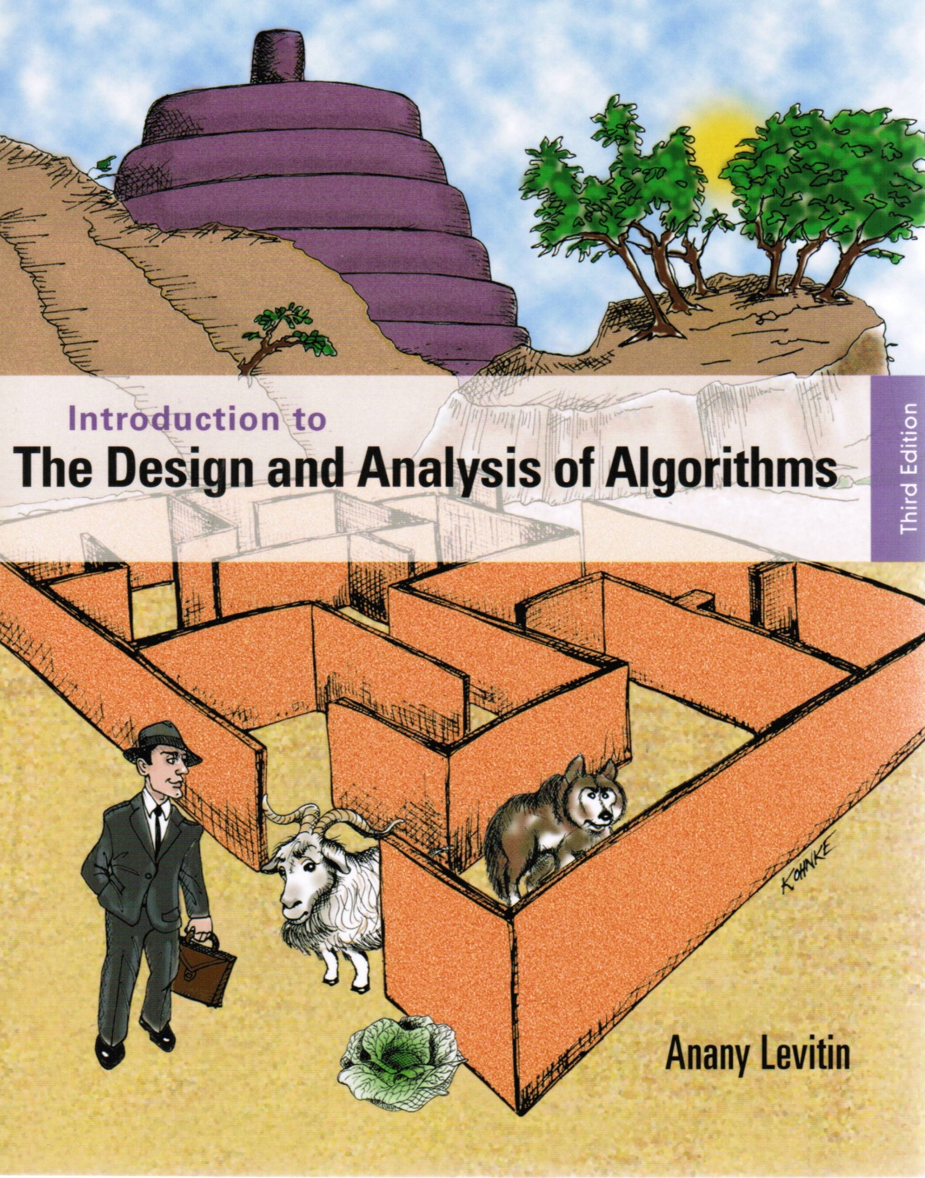
Chapter
Iterative
Improvement

Slide 3

Iterative Improvement
Algorithm design technique for solving optimization problems
Start with a feasible solution
Repeat the following step until no improvement can be found:
change the current feasible solution to a feasible solution with a better value of the objective function
Return the last feasible solution as optimal
Note: Typically, a change in a current solution is “small”. In other words, the improvement in an iteration (or step) is small.
Notes:
These were discussed in the first lecture. At this point, the claims made then about
“efficient” algorithms can be discussed in more concrete terms.
Before launching into this lecture, I usually read to my students the introductory whimsical
example from Garey and Johnson “Computers and Intractability”, while showing
overhead transparencies of their cartoons. These are not reproduced here because it would
require copyright clearance.

Slide 4
Important Examples
Ford-Fulkerson algorithm for maximum flow problem
Gale-Shapley algorithm for the stable marriage problem

Slide 5
Maximum Flow Problem
Problem of maximizing the flow of a material through a transportation network (e.g., pipeline system, communications or transportation networks)
Formally represented by a connected weighted digraph with n vertices numbered from 1 to n with the following properties:
containing exactly one vertex with no entering edges, called the source (numbered 1)
containing exactly one vertex with no leaving edges, called the sink (numbered n)
having positive integer weight u_{ij} on each directed edge (i.j), called the edge capacity, indicating the upper bound on the amount of the material that can be sent from vertex i to vertex j through this edge

Slide 6
Example of Flow Network
5
4
3
Source
2
5
2
1
2
3
6
3
Sink
1
4

Slide 7
Capacity and Material Amount
u_{ij} is the capacity of the edge from vertex i to vertex j. It is the upper bound of amount of the material sent from i to j in a unit of time.
x_{ij} is amount of the material being sent from vertex i to vertex j in a unit of time.
r_{ij} = u_{ij} – x_{ij} is the unused capacity of the edge from vertex i to vertex j.
A flow is for a network or a path. It is an assignment of x_{ij} to edges (i,j) of the network or path.

Slide 8
Definition of a Flow
A flow is an assignment of real numbers x_{ij} to edges (i,j) of a given network/path that satisfy the following constraints:
flow-conservation constraints The total amount of material entering an intermediate vertex must be equal to the total amount of the material leaving the vertex
capacity constraints
0 ≤ x_{ij} ≤ u_{ij} for every edge (i,j) ∈ E (2)
∑ x_{ji} = ∑ x_{ij} for i = 2,3,…, n-1 (1)
j: (j,i) є E j: (i,j) є E

Slide 9
Flow Value and Maximum Flow Problem
Since no material can be lost or added to by going through intermediate vertices of the network, the total amount of the material leaving the source must end up at the sink:
∑ x_{1j} = ∑ xjn (3)
The value of the network flow is defined as the total outflow from the source (= the total inflow into the sink).
The maximum flow problem is to find a flow of the largest value (maximum flow) for a given network.
j: (1,j) є E j: (j,n) є E

Slide 10

Augmenting Path (Ford-Fulkerson) Algorithm
Start with the zero flow (x_{ij} = 0 for every edge)
On each iteration, try to find a flow-augmenting path from source to sink, along which some additional flow can be sent. (A path is an interleaved sequence of vertex-edge-vertex-…-edge-vertex from source to sink.)
An edge can be used as a forward edge if $u−x>0.$
An edge can be used as a backward edge if $x>0$.
If a flow-augmenting path is found, update the material amounts along the edges of this path to get a flow of increased value and try again to find another path.
If no flow-augmenting path is found, the current flow is maximum.

Slide 11
Example
5
0/3
0/4
0/2
0/5
0/2
1
2
3
6
0/3
0/1
x_{ij}/u_{ij}
4
Augmenting path:
1→2 →3 →6

Slide 12
Example (cont.)
5
0/3
0/4
2/2
2/5
2/2
1
2
3
6
0/3
0/1
4
The material amounts of the edges along this path are updated

Slide 13
Example (cont.)
5
0/3
0/4
2/2
2/5
2/2
1
2
3
6
0/3
0/1
4
Augmenting path:
1 →4 →3←2 →5 →6

Slide 14
Example (cont.)
5
0/3
0/4
2/2
2/5
2/2
1
2
3
6
0/3
0/1
4
Augmenting path:
1 →4 →3←2 →5 →6

Slide 15
Example (cont.)
5
1/3
1/4
2/2
1/5
2/2
1
2
3
6
1/3
1/1
The material amounts of the edges along this path are updated
4

Slide 16
Example (maximum flow)
5
1/3
1/4
2/2
1/5
2/2
1
2
3
6
1/3
1/1
Find the max flow value 1+2= 3
at the source or sink
4

Slide 17
Finding a flow-augmenting path
To find an augmenting path, consider paths from source to sink in the underlying undirected graph in which any two consecutive vertices i,j are either:
connected by a directed edge (i to j) with some positive unused capacity r_{ij} = u_{ij} – x_{ij}
known as forward edge ( → )
OR
connected by a directed edge (j to i) with positive flow x_{ji}
known as backward edge ( ← )
If an augmenting path is found, the current flow can be increased by r units by increasing x_{ij} by r on each forward edge and decreasing x_{ji} by r on each backward edge, where r = min {r_{ij} on all forward edges, x_{ji} on all backward edges}

Slide 18
Finding a flow-augmenting path (cont.)
Find a path from the source to sink, for example, using a DFS-like method.
In finding a path,
we can include an edge in the path as a forward edge if the edge’s unused capacity is greater than 0, and
we can include an edge in the path as a backward edge if the edge’s current material amount is greater than 0.
After each iteration, the flow value increases by at least 1.
When no more augmenting path can be found, stop the process and calculate the maximum flow value at the source.
Maximum value is bounded by the sum of the capacities of the edges leaving the source; hence the augmenting path algorithm must stop after a finite number of iterations.

Slide 19
Performance Degeneration of the Method
The augmenting path algorithm may select a bad sequence of augmenting paths.
A bad sequence of augmenting paths could impact the method’s efficiency
Example
2
0/U
0/U
1
0/1
3
U = large positive integer
Source = vertex 1
Sink = vertex 3
0/U
0/U
4

Slide 20
Example
2
2
0/U
0/U
1/U
0/U
1
0/1
3
1
1/1
3
V=1
0/U
0/U
0/U
1/U
1→2→4→3
4
4
1→4←2→3
2
2
U/U
U/U
1/U
1/U
V=2U
1
0/1
3
● ● ●
1
0/1
3
V=2
U/U
U/U
1/U
1/U
4
4
Requires 2U iterations to reach maximum flow of value 2U

Slide 21
A Different Sequence of Augmenting Paths
Maximum flow = U+U=2U
2
2
2
0/U
0/U
U/U
U/U
U/U
U/U
1
0/1
3
1
0/1
3
1
0/1
3
0/U
0/U
0/U
0/U
U/U
U/U
4
4
4

Slide 22
Shortest-Augmenting-Path Algorithm
Generate augmenting path with the least number of edges by breadth-first-search (BFS) as follows.
Starting at the source, perform BFS traversal by marking new (unlabeled) vertices with two labels:
first label – indicates the amount of additional material that can be sent from the source to the vertex being labeled
second label – indicates the vertex from which the vertex being labeled was reached, with “+” or “–” added to the second label to indicate whether the vertex was reached via a forward or backward edge.
At each step, starting at the vertex at the head (front) of the queue to label each unlabeled neighbor, if there is an edge to go through. Then dequeue the head.

Slide 23
Vertex Labeling
The source is always labeled with ∞,-
The labels of vertex i are l_{i},v⁺ or l_{i},v⁻
All vertices other than the source are labeled as follows:
If unlabeled vertex j is connected to the front vertex i of the traversal queue by a directed edge from i to j with positive unused capacity r_{ij} = u_{ij} –x_{ij} (forward edge), vertex j is labeled with l_{j},i⁺, where l_{j} = min{l_{i}, r_{ij}}
If unlabeled vertex j is connected to the front vertex i of the traversal queue by a directed edge from j to i with positive material amount x_{ji} (backward edge), vertex j is labeled l_{j},i⁻, where l_{j} = min{l_{i}, x_{ji}}

Slide 24
Vertex Labeling (cont.)
If the sink ends up being labeled, the current flow can be augmented by the amount indicated by the sink’s first label
The augmentation of the current flow is performed along the augmenting path traced by following the vertex second labels from sink to source; the current flow quantities are increased on the forward edges and decreased on the backward edges of this path
If the sink remains unlabeled after the traversal queue becomes empty, the algorithm returns the current flow as maximum and stops

Slide 25
Example: Shortest-Augmenting-Path Algorithm
5
0/3
0/4
∞,-
0/2
0/5
0/2
1
2
3
6
0/3
0/1
5
4
0/3
0/4
∞,-
2,1⁺
0/2
0/5
0/2
Queue: 1
↑
1
2
3
6
0/3
0/1
4
3,1⁺
Queue: 1 2 4
↑

Slide 26
Example (cont.)
2,2⁺
5
0/3
0/4
∞,-
2,1⁺
0/2
0/5
0/2
1
2
3
6
2,2⁺
2,2⁺
0/3
0/1
5
4
0/3
0/4
3,1⁺
∞,-
2,1⁺
2,3⁺
0/2
0/5
0/2
Queue: 1 2 4 3 5
↑
1
2
3
6
2,2⁺
0/3
0/1
4
3,1⁺
Queue: 1 2 4 3 5 6
↑
Augment the flow by 2 (the sink’s first label) along the path 1→2→3→6

Slide 27
Example (cont.)
2,2⁺
5
0/3
0/4
∞,-
2,1⁺
0/2
0/5
0/2
1
2
3
6
2,2⁺
2,2⁺
0/3
0/1
5
4
0/3
0/4
3,1⁺
∞,-
2,1⁺
2,3⁺
0/2
0/5
0/2
Queue: 1 2 4 3 5
↑
1
2
3
6
2,2⁺
0/3
0/1
4
3,1⁺
Queue: 1 2 4 3 5 6
↑
Augment the flow by 2 (the sink’s first label) along the path 1→2→3→6

Slide 28
Example (cont.)
5
0/3
0/4
∞,-
2/2
2/5
2/2
1
2
3
6
0/3
0/1
5
4
0/3
0/4
∞,-
2/2
2/5
2/2
Queue: 1
↑
1
2
3
6
0/3
0/1
4
3,1⁺
Queue: 1 4
↑

Slide 29
Example (cont.)
5
0/3
0/4
∞,-
2/2
2/5
2/2
1
2
3
6
1,4⁺
0/3
0/1
5
4
0/3
0/4
3,1⁺
∞,-
1,3⁻
2/2
2/5
2/2
Queue: 1 4 3
↑
1
2
3
6
1,4⁺
0/3
0/1
4
3,1⁺
Queue: 1 4 3 2
↑

Slide 30
Example (cont.)
1,2⁺
5
0/3
0/4
∞,-
1,3⁻
2/2
2/5
2/2
1
2
3
6
1,4⁺
1,2⁺
0/3
0/1
5
4
0/3
0/4
3,1⁺
∞,-
1,3⁻
1,5⁺
2/2
2/5
2/2
Queue: 1 4 3 2 5
↑
1
2
3
6
1,4⁺
0/3
0/1
4
3,1⁺
Queue: 1 4 3 2 5 6
↑
Augment the flow by 1 (the sink’s first label) along the path 1→4→3←2→5→6

Slide 31
Example (cont.)
5
1/3
1/4
∞,-
2/2
1/5
2/2
1
2
3
6
1/3
1/1
5
4
1/3
1/4
∞,-
2/2
1/5
2/2
1
2
3
6
Queue: 1
↑
1/3
1/1
4
2,1⁺
Queue: 1 4
↑
No augmenting path (the sink is unlabeled) the current flow is maximum

Slide 32
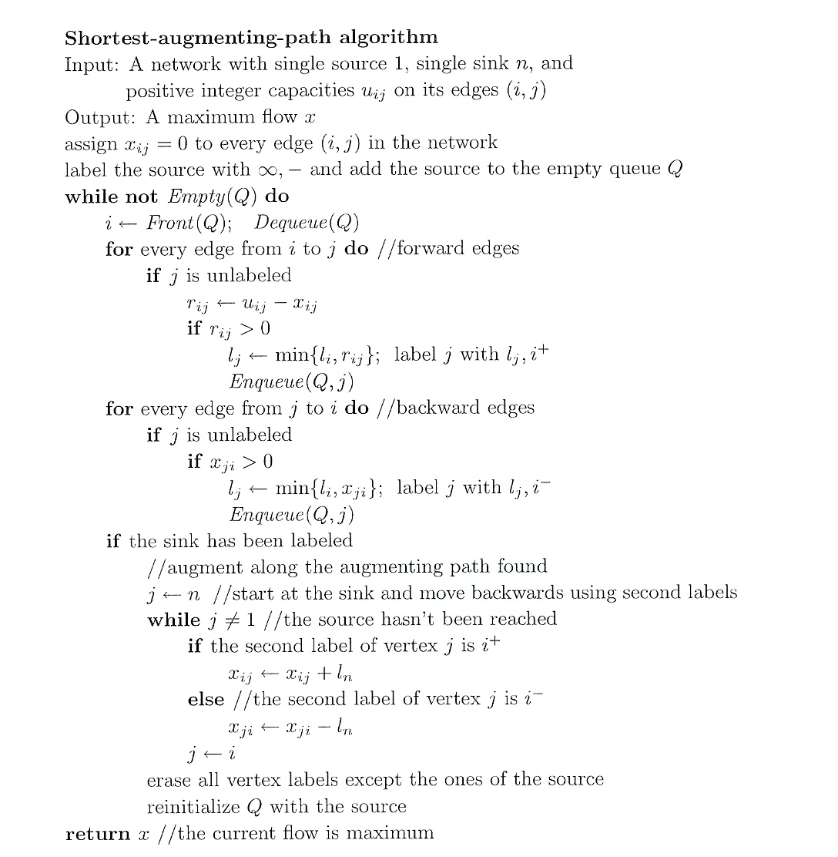

Slide 33
Example
U,1⁺
2
2
0/U
0/U
0/U
0/U
∞,-
∞,-
1
0/1
3
1
1/1
3
0/U
0/U
0/U
0/U
4
4
U,1⁺
Queue: 1
↑
Queue: 1 2 4
↑
U,1⁺
2
2
U/U
U/U
0/U
0/U
∞,-
1
0/1
3
1
0/1
3
U,2⁺
0/U
0/U
0/U
0/U
4
4
U,1⁺
Augmenting path of flow of U
Queue: 1 2 4 3
↑

Slide 34
Example (cont.)
2
2
U/U
U/U
U/U
U/U
∞,-
∞,-
1
0/1
3
1
1/1
3
0/U
0/U
0/U
0/U
4
4
U,1⁺
Queue: 1
↑
Queue: 1 4
↑
2
2
U/U
U/U
U/U
U/U
∞,-
1
0/1
3
1
0/1
3
U,4⁺
U/U
U/U
0/U
0/U
4
4
Augmenting path of flow of U
Maximum flow is 2U
U,1⁺
Queue: 1 4 3
↑

Slide 35
Time Efficiency
The number of augmenting paths needed by the shortest-augmenting-path algorithm never exceeds nm/2, where n and m are the number of vertices and edges, respectively
Since the time required to find an augmenting path by breadth-first search is in O(n+m)=O(m) for networks represented by their adjacency lists. The time efficiency of the shortest-augmenting-path algorithm is in O(nm²) for this representation

Slide 36
Stable Marriage Problem
There is a set Y = {m₁,…,m_{n}} of n men and a set X = {w₁,…,w_{n}} of n women. Each man has a preference (ranking) list of the women, and each woman has a preference list of the men (with no ties in these lists).
A marriage matching M is a set of n pairs (m_{i}, w_{j}).
A pair (m, w) is said to be a blocking pair for matching M if man m and woman w are not matched in M but prefer each other to their mates in M.
A marriage matching M is called stable if there is no blocking pair for it; otherwise, it’s called unstable.
The stable marriage problem is to find a stable marriage matching for men’s and women’s given preferences.

Slide 37
Instance of the Stable Marriage Problem
An instance of the stable marriage problem can be specified either by two sets of preference lists or by a ranking matrix, as in the example below.
men’s preferences women’s preferences
1st 2nd 3rd 1st 2nd 3rd
Bob: Lea Ann Sue Ann: Jim Tom Bob
Jim: Lea Sue Ann Lea: Tom Bob Jim
Tom: Sue Lea Ann Sue: Jim Tom Bob
ranking matrix
Ann Lea Sue
Bob 2,3 1,2 3,3
Jim 3,1 1,3 2,1
Tom 3,2 2,1 1,2

Slide 38
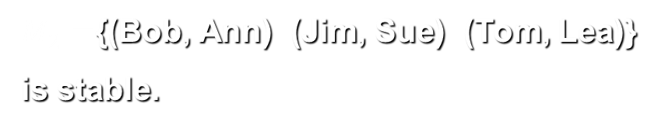
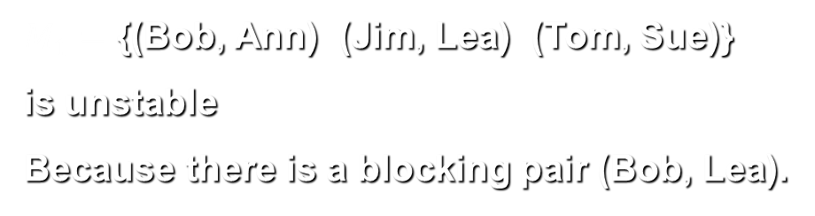
Instance of the Stable Marriage Problem
An instance of the stable marriage problem can be specified either by two sets of preference lists or by a ranking matrix, as in the example below.
men’s preferences women’s preferences
1st 2nd 3rd 1st 2nd 3rd
Bob: Lea Ann Sue Ann: Jim Tom Bob
Jim: Lea Sue Ann Lea: Tom Bob Jim
Tom: Sue Lea Ann Sue: Jim Tom Bob
ranking matrix
Ann Lea Sue
Bob 2,3 1,2 3,3
Jim 3,1 1,3 2,1
Tom 3,2 2,1 1,2
$M_{1}=$ {(Bob, Ann) (Jim, Lea) (Tom, Sue)}
is unstable
Because there is a blocking pair (Bob, Lea).
$M_{2}=${(Bob, Ann) (Jim, Sue) (Tom, Lea)}
is stable.

Slide 39
Stable Marriage Algorithm (Gale-Shapley)
Step 0 Start with all the men and women being free
Step 1 While there are free men, arbitrarily select one of them and do the following:
Proposal The selected free man m proposes to w, the next woman on his preference list
Response
-- If w is free, she accepts the proposal unconditionally to be matched with m.
-- If she is not free, she compares m with her current mate.
--- If she prefers m to him, she accepts m’s proposal, making her former mate free;
--- otherwise, she simply rejects m’s proposal, leaving m free.
Step 2 Return the set of n matched pairs

Slide 40
Example
 | Ann | Lea | Sue
Bob | 2,3 | 1,2 | 3,3
Jim | 3,1 | 1,3 | 2,1
Tom | 3,2 | 2,1 | 1,2
Free men: Bob, Jim, Tom
Bob proposes to Lea, Lea accepts
 | Ann | Lea | Sue
Bob | 2,3 | 1,2 | 3,3
Jim | 3,1 | 1,3 | 2,1
Tom | 3,2 | 2,1 | 1,2
Free men: Jim, Tom
Jim proposed to Lea, Lea rejects

Slide 41
Example (cont.)
 | Ann | Lea | Sue
Bob | 2,3 | 1,2 | 3,3
Jim | 3,1 | 1,3 | 2,1
Tom | 3,2 | 2,1 | 1,2
Free men: Jim, Tom
Jim proposes to Sue, Sue accepts
 | Ann | Lea | Sue
Bob | 2,3 | 1,2 | 3,3
Jim | 3,1 | 1,3 | 2,1
Tom | 3,2 | 2,1 | 1,2
Free men: Tom
Tom proposes to Sue, Sue rejects

Slide 42
Example (cont.)
 | Ann | Lea | Sue
Bob | 2,3 | 1,2* | 3,3
Jim | 3,1 | 1,3 | 2,1
Tom | 3,2 | 2,1 | 1,2
Free men: Tom
Tom proposes to Lea, Lea replaces Bob with Tom
 | Ann | Lea | Sue
Bob | 2,3 | 1,2 | 3,3
Jim | 3,1 | 1,3 | 2,1
Tom | 3,2 | 2,1 | 1,2
Free men: Bob
Bob proposes to Ann, Ann accepts

Slide 43
Analysis of the Gale-Shapley Algorithm
The algorithm terminates after no more than n² iterations with a stable marriage output
The stable matching produced by the algorithm is always man-optimal: each man gets the highest rank woman on his list under any stable marriage. One can obtain the woman-optimal matching by making women propose to men
A man (woman) optimal matching is unique for a given set of participant preferences
The stable marriage problem has practical applications such as matching medical-school graduates with hospitals for residency training

Slide 44
Design techniques and problem types
 | Search | Sorting | Tree | Graph | Other
Brute force, exhaustive search | Sequential search, Sequential string match | Selection sort, Bubble sort |  | Traveling salesman problem, DFS, BFS | Knapsack problem, Assignment problem
Decrease and conquer | Binary search | Insertion sort | Binary search tree | Topological sorting | Exponentiation by squaring
Divide and conquer |  | Mergysort, Quicksort | Binary tree traversal |  | Matrix multiplication, Large integer multiplication
Transform and conquer | Presorting | Heapsort | AVL tree, 2-3 tree |  | Gaussian elimination, Polynomial evaluation
Space and time tradeoff | Hashing, Horspool’s algorithm, BM algorithm | Sorting by counting
Dynamic programming |  |  | Optimal binary search trees | Shortest paths problem | Knapsack problem, Memory functions
Greedy techniques |  |  |  | Minimum spanning tree Shortest paths problem | Huffman trees
Iterative improvement |  |  |  | Maximum flow | Stable marriage problem
Backtracking Branch & bound |  |  |  | Traveling salesman problem, | N-queens, Assignment, Knapsack

Slide 45
Recommended Reading
10.2
10.4

